Slide 1
Machine learning workshop
Some slides are from EE5907,EE5730 NUS, Wikipedia, Kevin Murphy’s textbook and Matlab toolbox

Slide 2
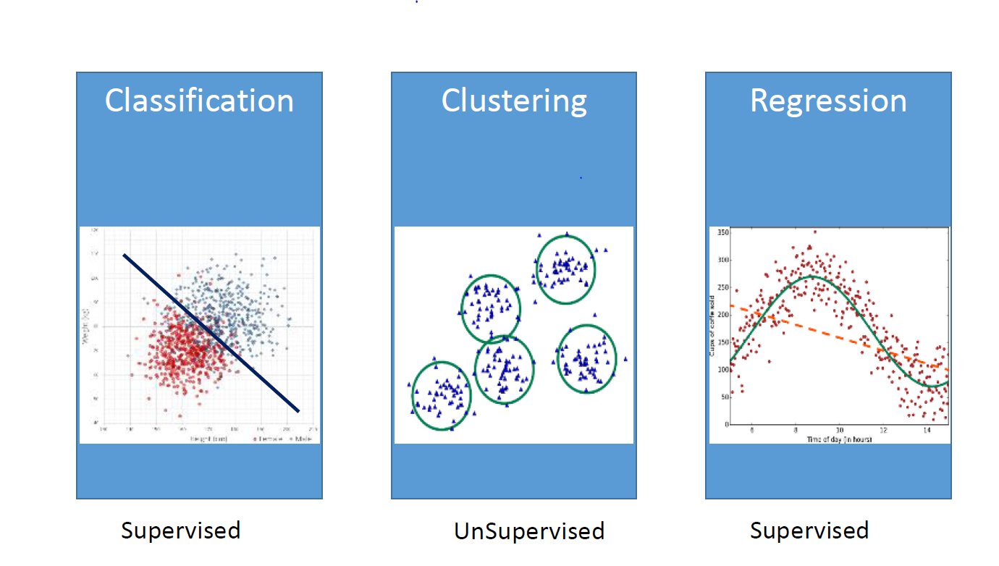

What machine learning can do

Slide 3
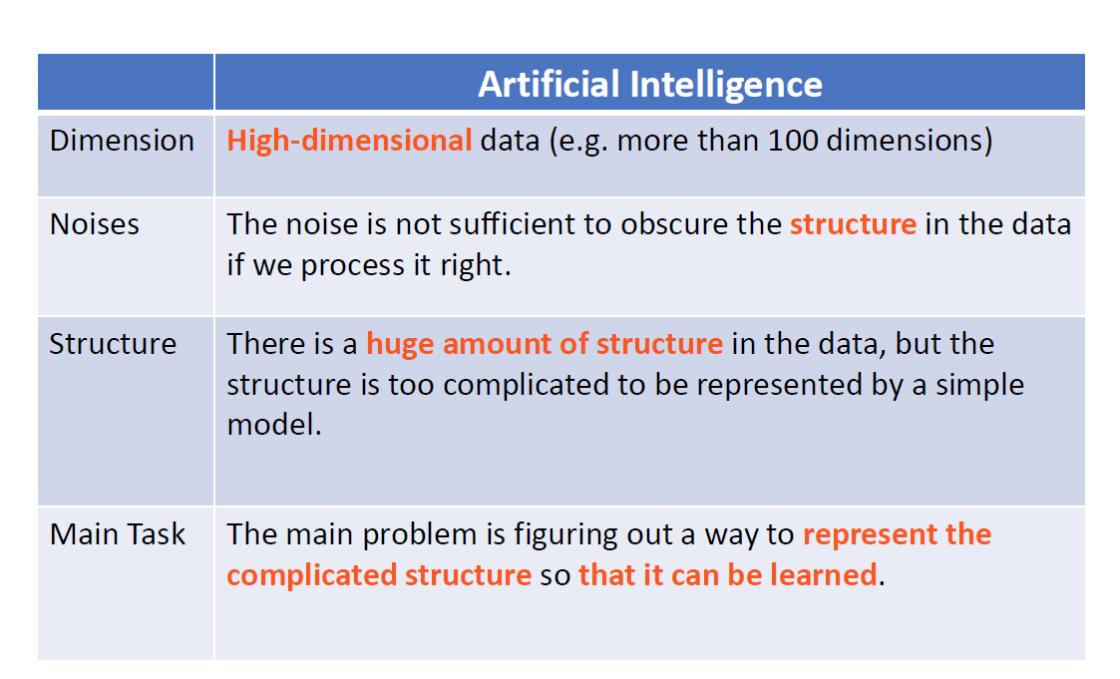
Why machine learning

Slide 4
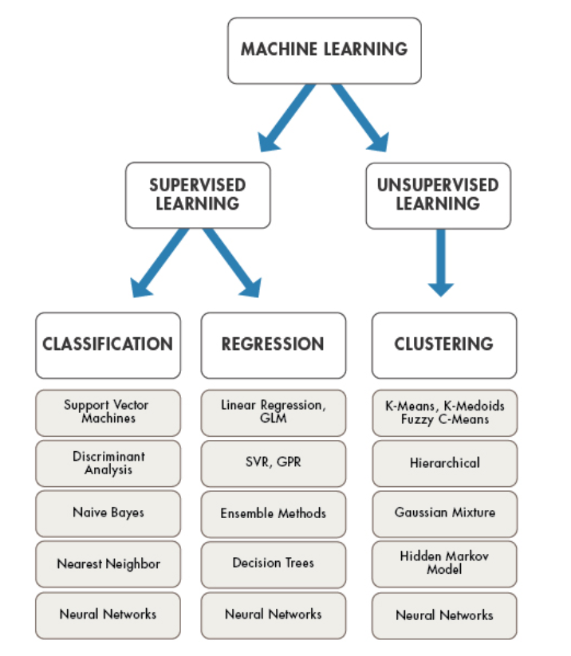
Types of machine learning

Slide 5
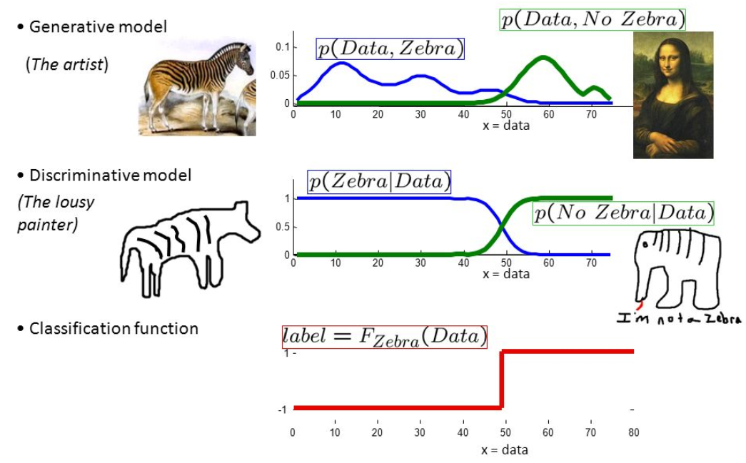
Discrimitive vs Generative model

Slide 6
Supervised learning: Naïve Bayes
Mammogram Test:
0.4% of women at age 40 have breast cancer
80% women with breast cancer will get positive mammographies
10% women without breast cancer will also get positive mammographies
A 40 year old women get positive results from mammogram test, what is the probability this women have breast cancer?

Slide 7
Breast Cancer Example
Notes:
This is why the US government no longer recommends routine mammogram for womens in their 40s because the prior probability of 40 year old woman having breast cancer is so low, and current mammograms are not sufficiently sensitive and the false positive rate is too high.
So even if the test comes back positive, there is still very low probability that the woman has breast cancer.

Slide 8
Supervised learning: boosting

Slide 9
Supervised learning: boosting

Slide 10
Supervised learning: boosting

Slide 11
Supervised learning: boosting

Slide 12
Supervised learning: boosting

Slide 13
Supervised learning: boosting

Slide 14
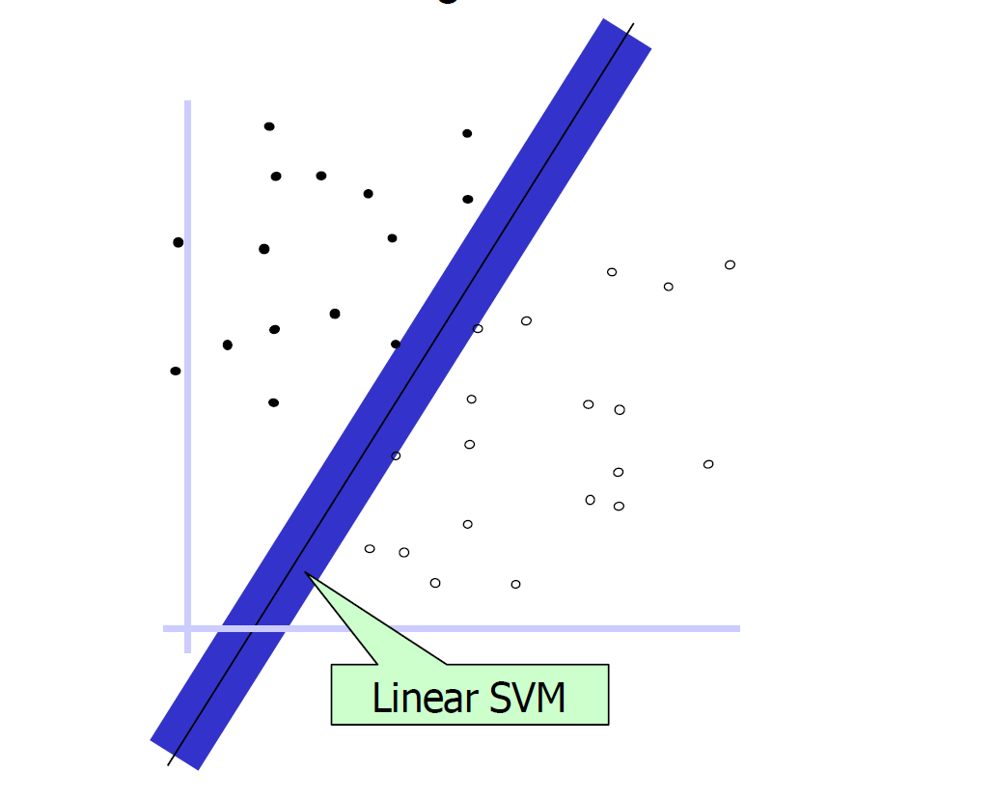
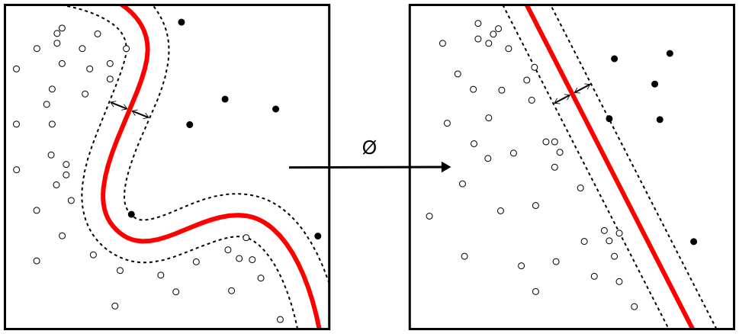
Supervised learning: Support vector machine
Linear support vectors
Polynomial support vectors

Slide 15
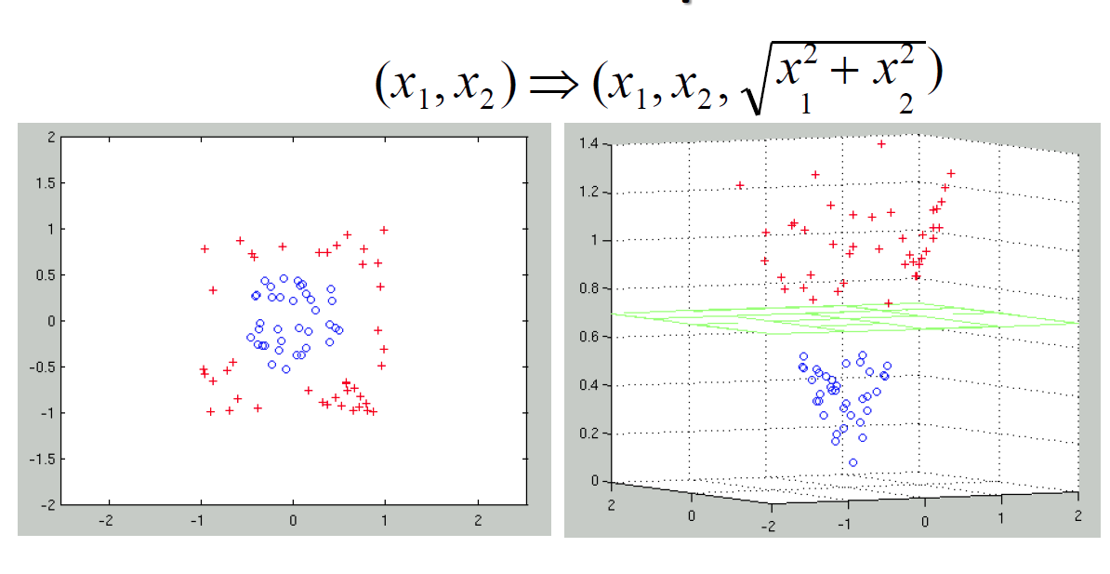
Supervised learning: Support vector machine

Slide 16
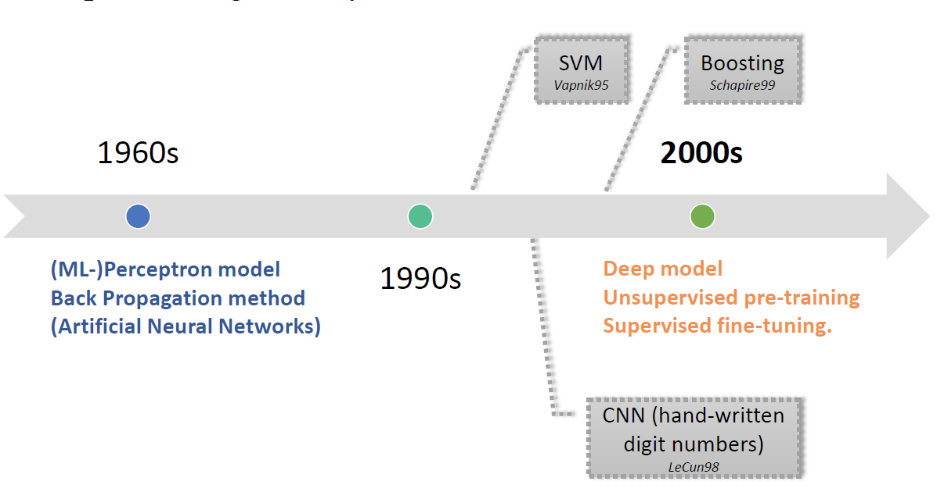
Supervised learning: neural network(Deep learning)

Slide 17
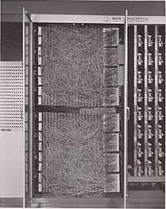
Neural network from solar perspective
Si
Perov
Inverter
III-V
SnS
I_{in} = w₁*I_{Si}+ w₂*I_{perov} + w₃*I_{III-V}…...
I_{out} = f(I_{in})
The Mark I Perceptron machine (1958)

Slide 18
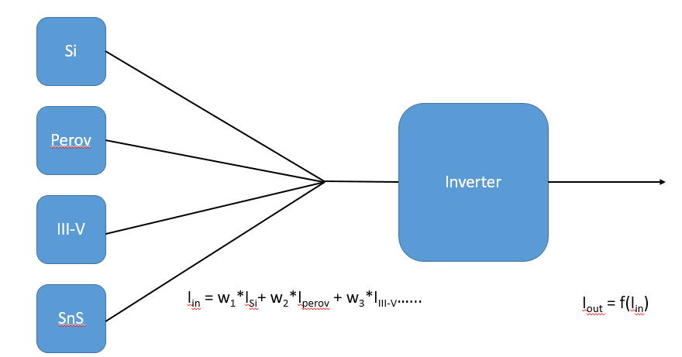
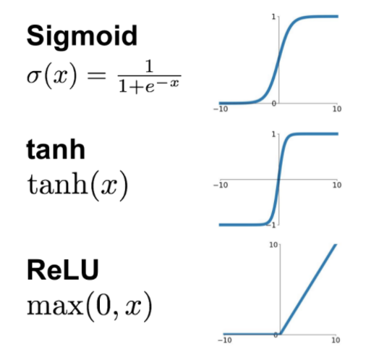
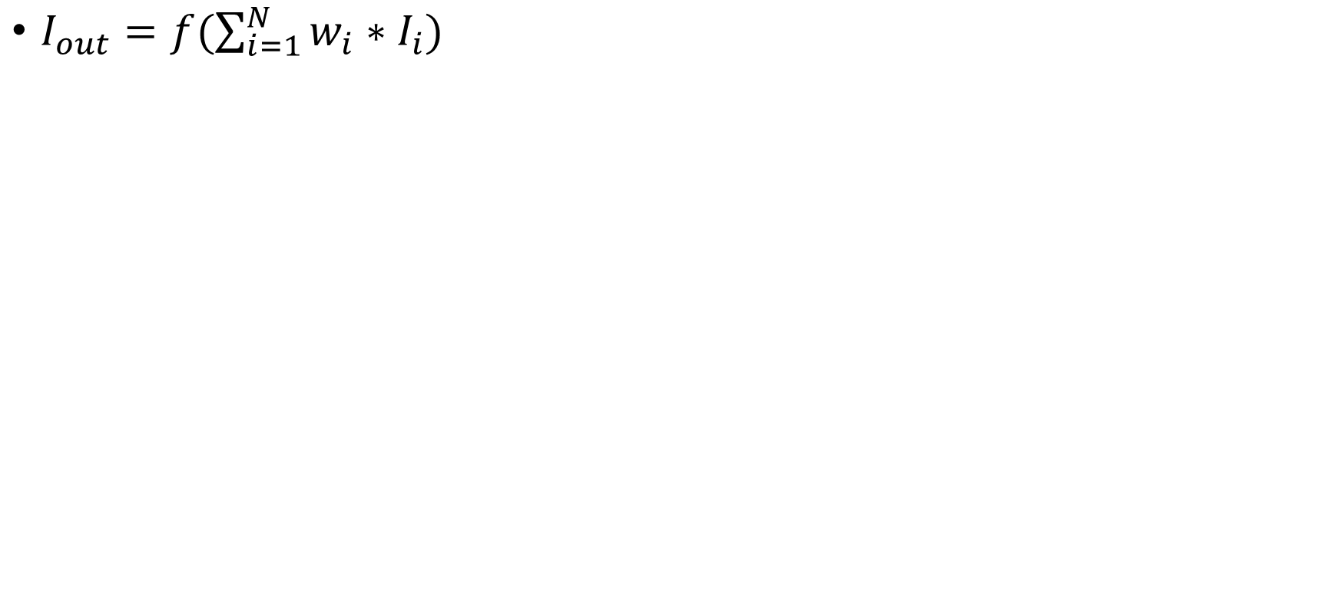
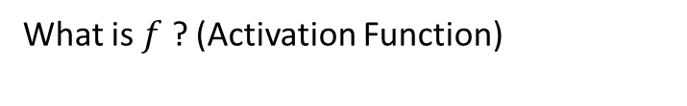
Nerual network from solar perspective
$I_{out}=f(\sum_{i=1}^{N}{w_{i}∗I_{i})}$
What is $f$ ? (Activation Function)

Slide 19
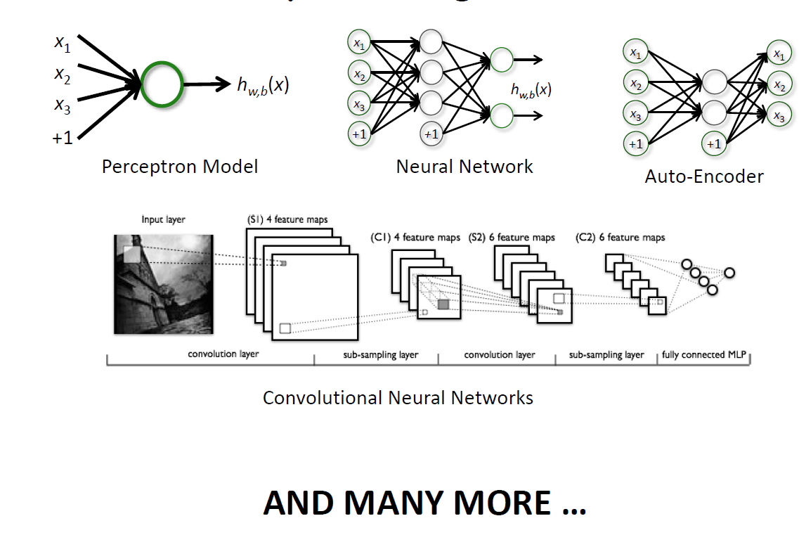
Supervised learning: neural network

Slide 20
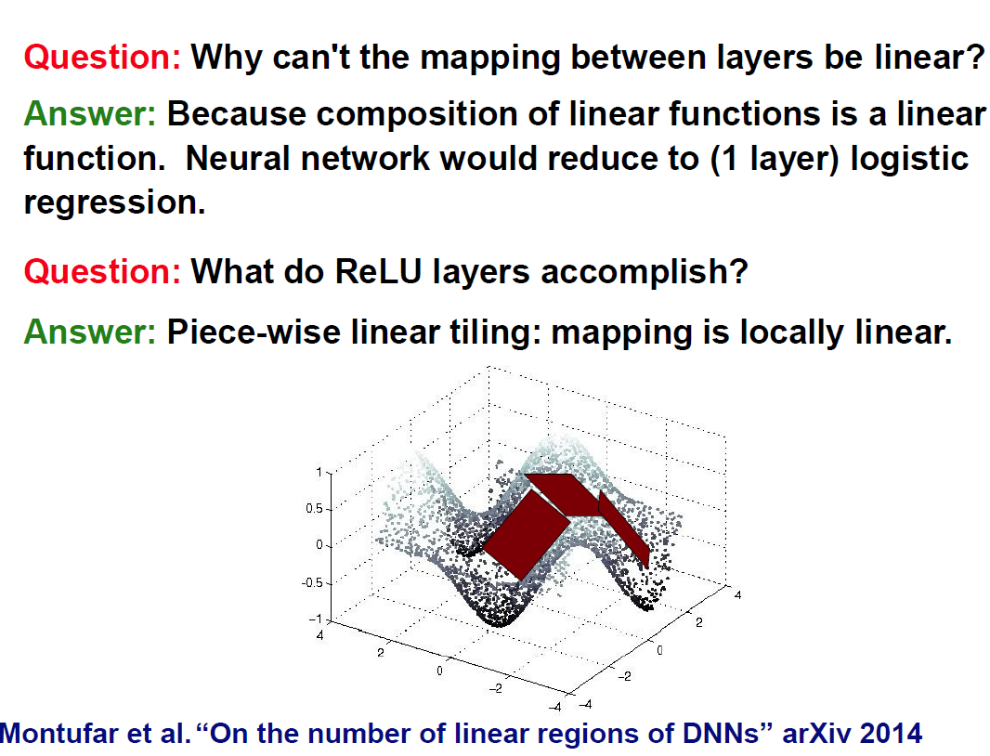
Why do we need the activation function f

Slide 21
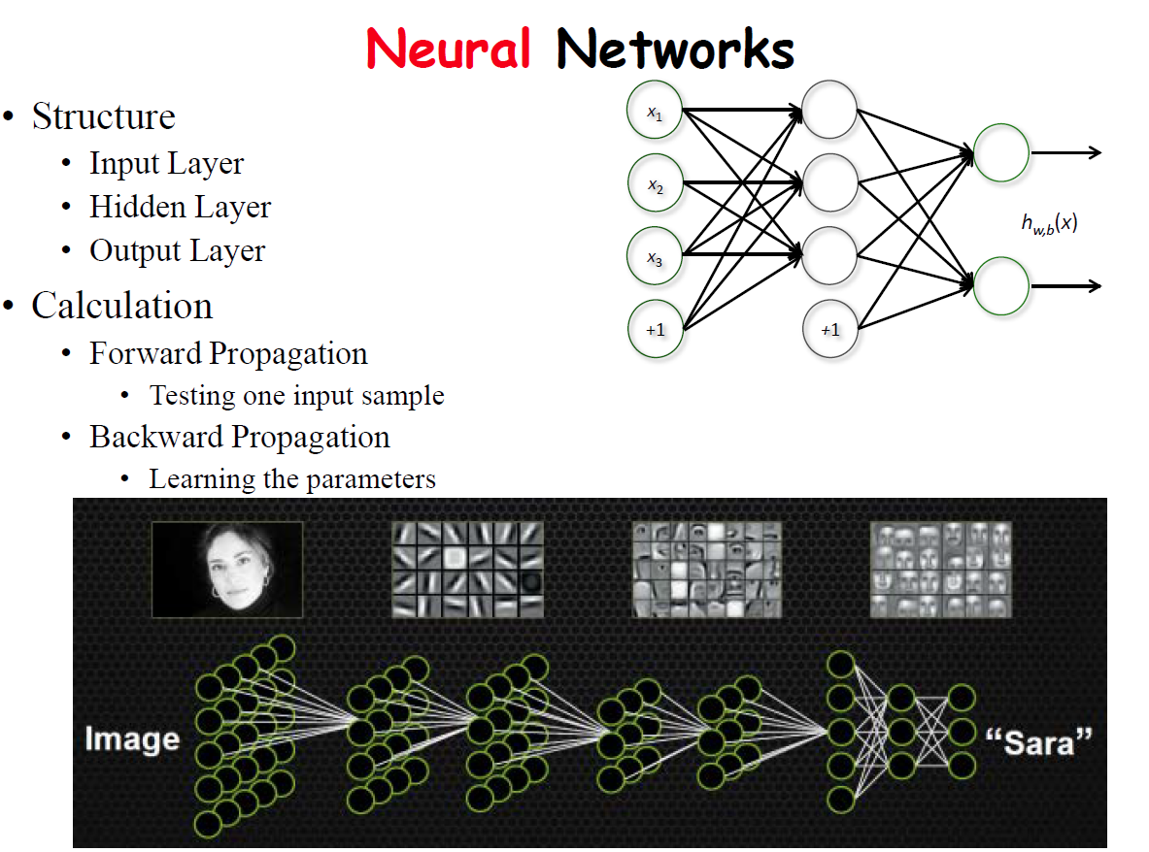
Neural network structure

Slide 22
Unsupervised learning(Feature extraction): Principle Component Analysis

Slide 23
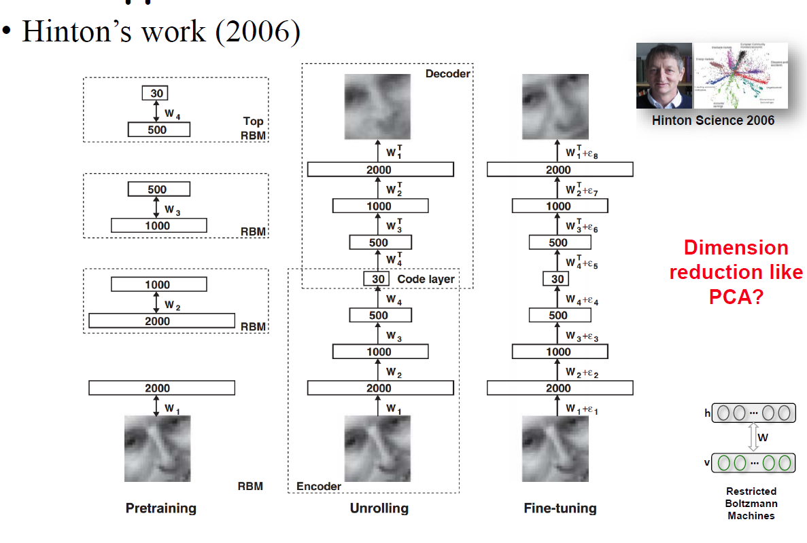
Unsupervised learning(Feature extraction): Auto-encoder

Slide 24
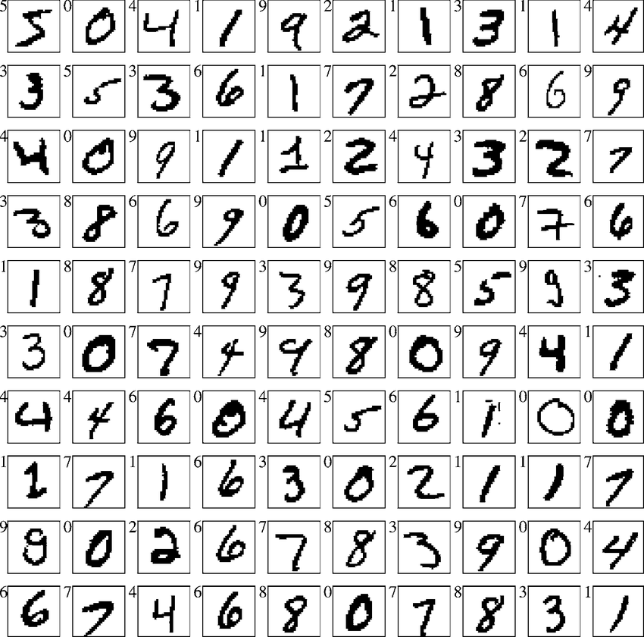
Hands on session: MNIST dataset
60,000 pictures
28*28 pixel for each picture
784 features (intensity value of each pixel)
50,000 pictures used as training data
10,000 pictures used as test data
We will do this training and testing using different algorithm and compare the results!

Slide 25
Installation guide
Download Anaconda with Python 3.6 version
Download codes from
Open Anaconda Prompt
Install required python packages by typing
conda install mpl_toolkits
conda install tensorflow

Slide 26
Hands on session: results
Method | Run time[s] | Accuracy [%]
Naïve Bayes | 0.2 | 83.69
K nearest neighbors | 2326 | 95.10
Logistic Regression | 51 | 91.99
Random forest | 2.5 | 93.84
Decision Tree | 14 | 87.14
Support Vector Machine | 2887 | 94.35
Boosting | 5712 | 96.18
Neural network (adaptive layer) | 12 | 97.85
Neural network with 1 layer | 12 | 70.15

Slide 27
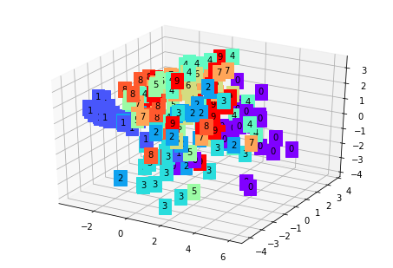
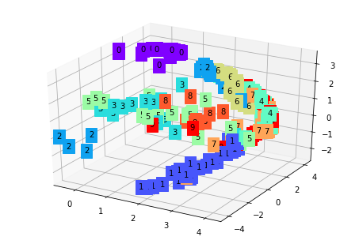
Feature reduction
Principle component analysis
Autoencoder (Neural network)

Slide 28
Is it so simple ?
Data starving process: significant amount of informative data
Preprocessing of your data
Tuning hyper parameters in the model
Defining the loss function
No free lunch theorm (define your model for your problem)

Slide 29
Back up slides

Slide 30
Supervised learning: Naïve Bayes failure
Mammogram Test:
0.4% of men at age 40 have lung cancer
80% men with lung cancer smoke
10% men without lung cancer smoke
A 40 year old men who smoke, what is the probability this men have lung cancer?

Slide 31
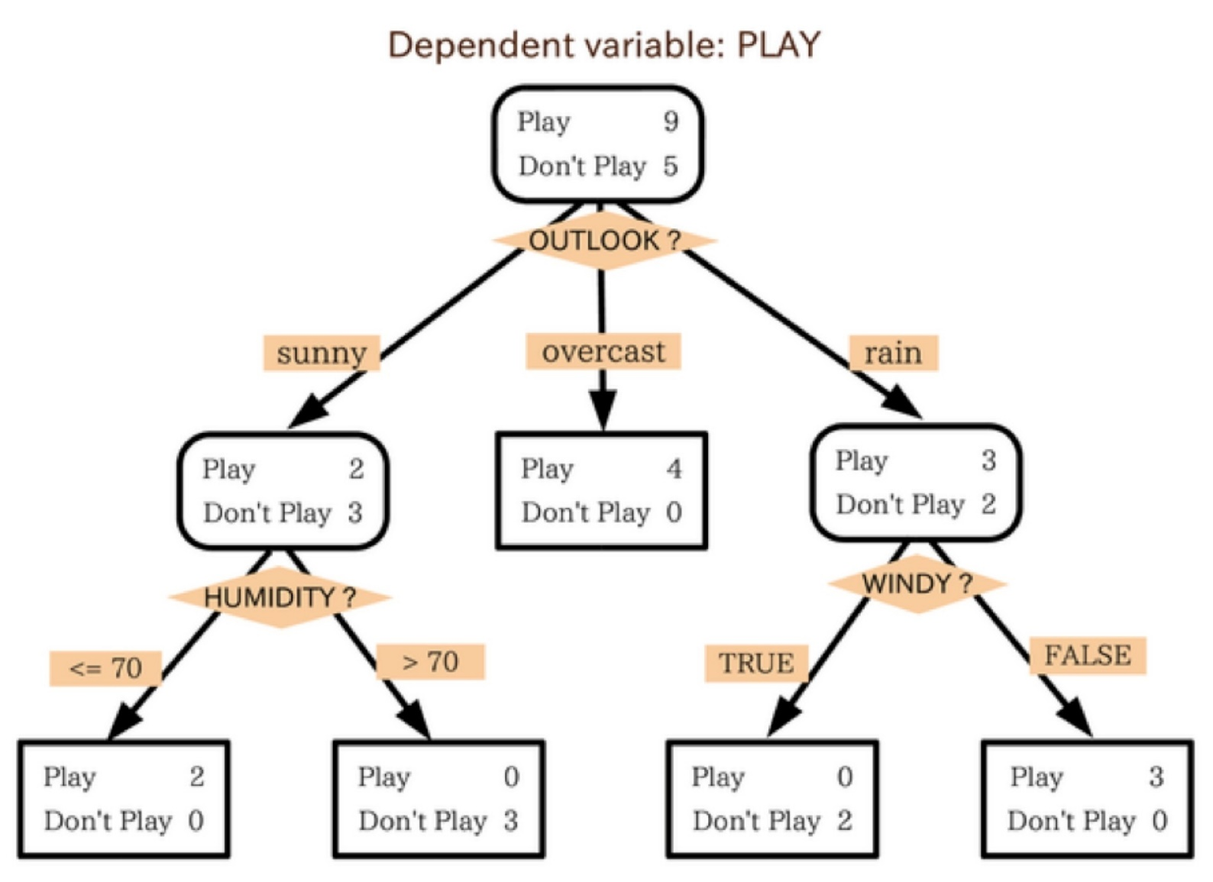
Supervised learning: random forest

Slide 32
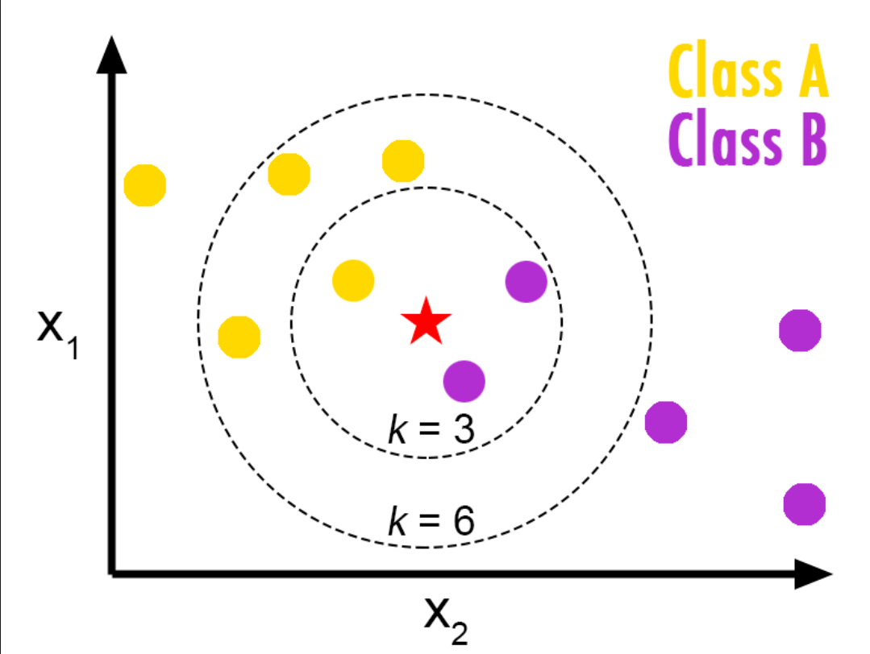
Supervised learning: K nearest neighbour

Slide 33
Generative vs Discriminative Models (1)
Notes:
Once we know theta, we can generate a data pair x and y, by first sampling y from the class distribution p of y given theta.
And then given y and theta, we can sample x from the likelihood p of x given y and theta.

Slide 34
Generative vs Discriminative Models (2)
Notes:
On the other hand, if we have a generative model, we can try to sample data from the model. And if the simulated data looks like real data, this would suggest the model is good.
If the simulated data does not look like real data, we might be able to visually tell how to improve the model so the simulated data looks like real data.
And if the simulated data looks like real data, then generative classifier can perform very well.

Slide 35
Deriving Bayes’ Rule
From before:
Equate RHS
Combining:
Re-arranging:
Adapted from S. Prince
Notes:
The final equality is obtained by keeping the numerator the same, and using the fact that p(x, y) is equal to p(y) TIMES p(x|y).
These three equations are known as Bayes rule. <PAUSE>
In this derivation, y is a continuous random variable. That’s why we use the integral sign.

Slide 36
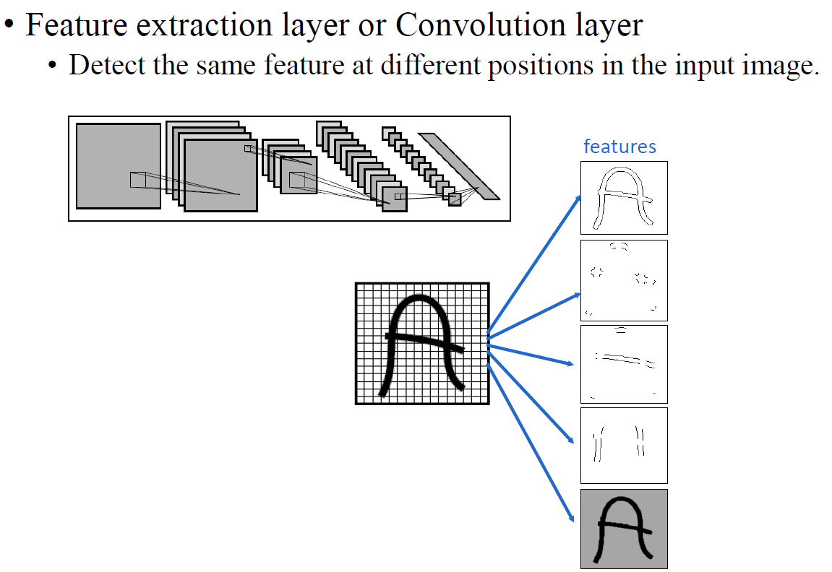
Convolutional neural network

Slide 37
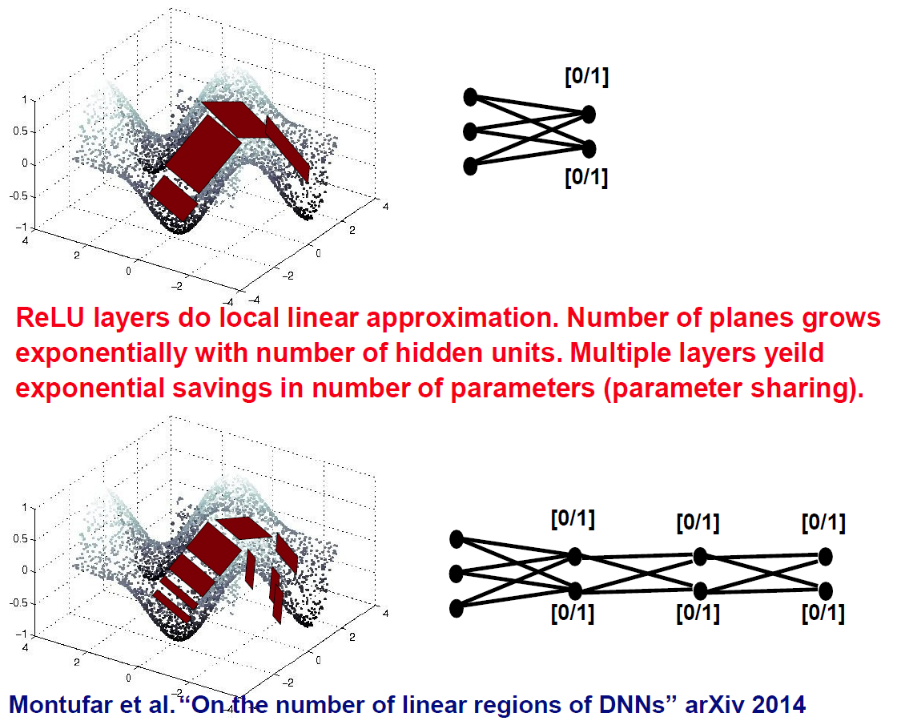
Why multi-layer

